Slide 1
The Sportify India
Team Members:
ANURAG DESHMUKH
GAURAV PATIL
MANMATH HALKUDE
NEHA NIKALJE
PRAFULLA WAGH
RUSHIKESH MOHITE
Institute of Emerging Technologies (IET)

Slide 2
Tables of contents
Introduction of Project
The Online Sports store facilities
Modules
Future scope

Slide 3





Slide 4

INTRODUCTION
THE SPORTIFY INDIA is a web based E-Commerce application specially designed for only sports products. Customer can get Sports products with categories which make them easy to find out. Customer can get all products with different category with single product. It is the platform where sellers can sell their products by assigning them on this web application and easier interaction with customers.

Slide 5
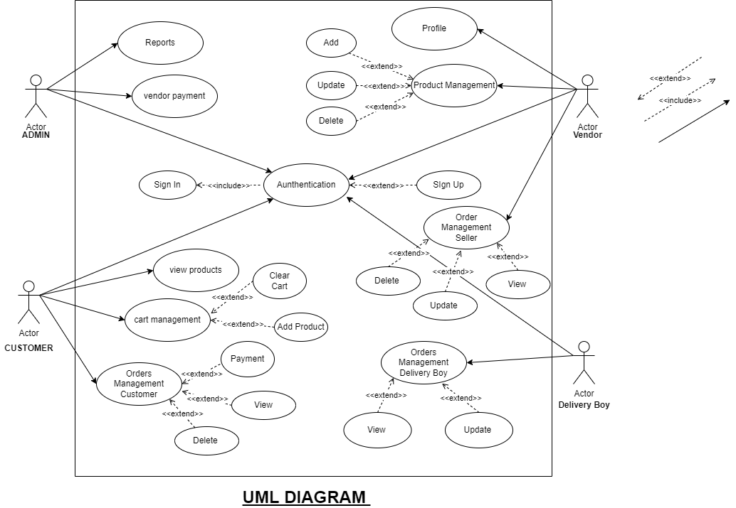

Slide 6
MODULES
Home
Admin
Login
Category
Cart

Slide 7
FEATURES
Order & Shipping Management
Authentication & Registration
Inventory Management
Reports
Shop by Category and Discount

Slide 8
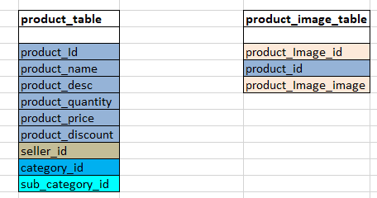
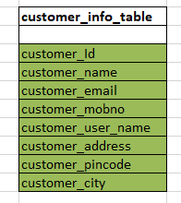
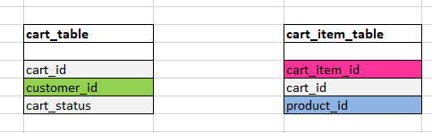
General Schema

Slide 9
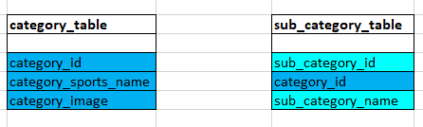
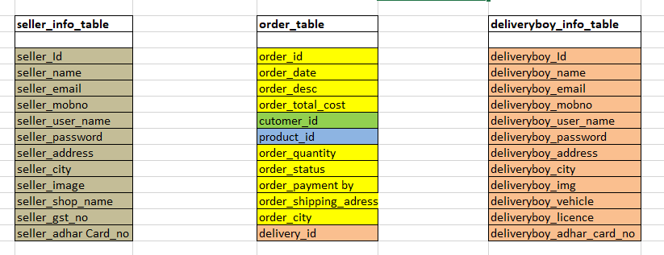

Slide 10

Thank you

